Slide 1


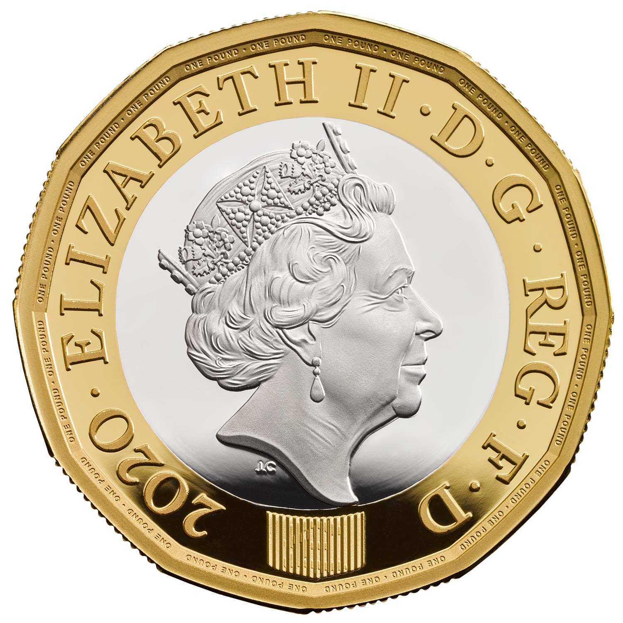
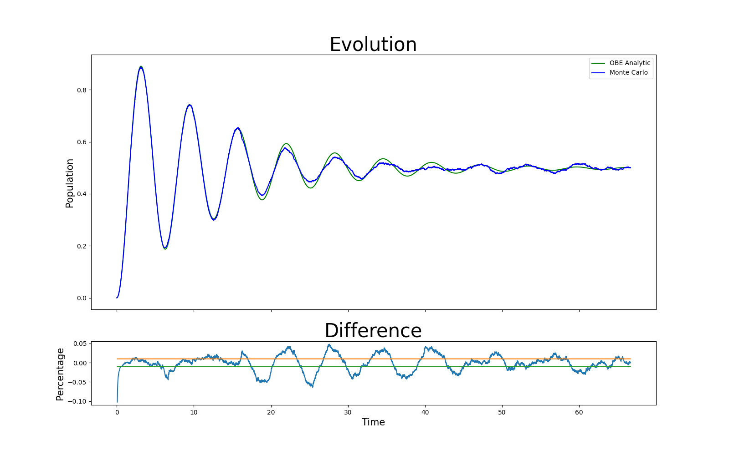
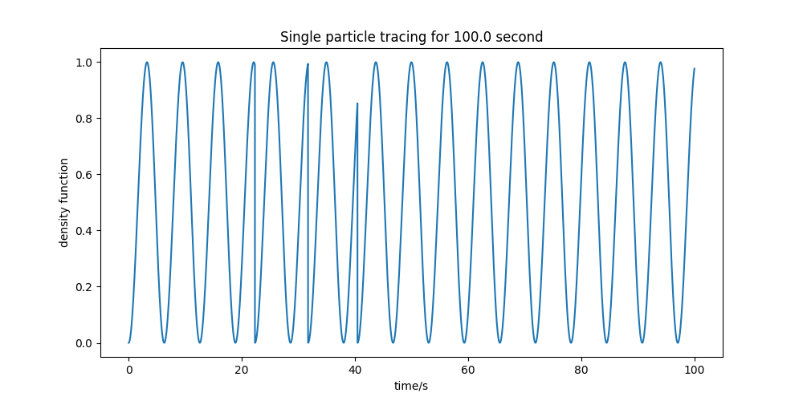

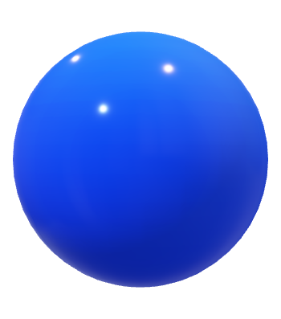
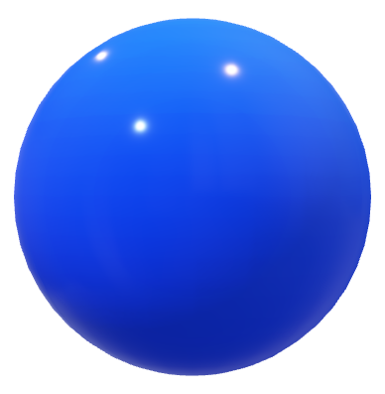
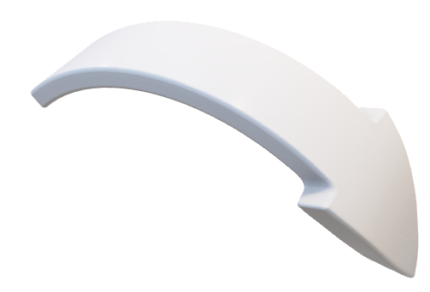
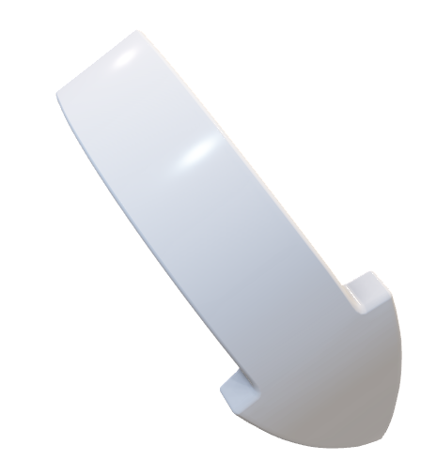

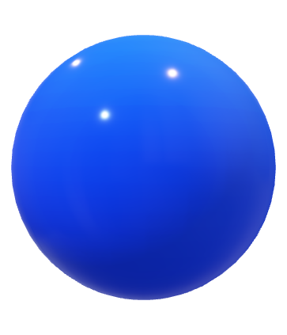
Qubit Dynamics: Introducing to Future Computing Technology
In quantum computing and information, a qubit is a key building block that represents a two-level quantum system. The property that it can state in a superposition of state 0 and state 1 provide an outstanding ability in storing data in limited space. It is widely used in highest level data storage, computing. Google has verified the ‘Quantum Supremacy’ that quantum computing technology will dominate the computer field in the future theocratically, and the latest quantum computer can manipulate with more than hundreds of particles in quantum phases, contributing unimaginably to calculation and research. Here is the basic explanation to the qubit and an easy represent on how to simulate a quantum phenomenon on a classical computer, and what benefits and meanings this way can bring to us .
What is Qubit
Monte Carlo Algorithm
--simulation
Optical Bloch Equation
--numerical solution
Qubit, also known as Quantum bit, is a concept in quantum physics. It is a particle that exists in a superposition state. Throw a classic coin, the result would be either face up or face done. However, a ‘quantum coin’ could represent both face up and face done.
Monte Carlo simulation is a way to simulate a random phenomenon. It has been regarded as one of the best way do describe random phenomenon using classical way. The key features of this simulation is comparison, iteration, .At a specific time, a random number is generated, and one comparison is made due to some rules. After the comparison, the function steps to the next time after a short period δt. A complete evolution is shown in the flowchart. The hole Monte Carlo simulation is the repetition of these steps, and a typical trajectory of a single particle is shown below in Fig 1.
Optical Bloch equation is the analytical way to calculate the evolution of the particles. In this circumstance it was used as a comparison to the Monte Carlo way, examining its reliability.
The comparison of Monte Carlo(blue line, with sum of 1000 particles) and Optical Bloch Equation(green lane) is shown below in Fig 2. The result for both lines shows a great fit with difference fluctuating within 3%. Most differences lay in 1% error as expected, showing a strong reliability for Monte Carlo algorithm.
Once we prove that the Monte Carlo simulation is trustable, we could simplify plenty of questions into simulation, rather than calculation. This is a better realization that it simplifies the condition required, replaced by millions of trials. It also provides a way for computers to improve the parameters by themselves, which leads to the combination with machine learning, that would make research efficient and convenient.
Face Down
Face Up
Face Up and Down
Similarly, as a common bit could only represent 0 or 1 in binary system, a quantum bit can represent both 0 and 1 state. Represent this 0 and 1 as wave, and call 0 “Spin down”, call 1 “Spin up”, we get the basic quantum represent for a qubit.
Comparison
Compared with a random generated value
Iteration
Normalisation
Normalise the wave to prevent evolution from divergence
Derive the expression of wave at time (t+δt).
Based on the comparing result, apply different method to the wave.
Spin Up
Spin Down
Superposition state
The property of qubit enables it to contain more information than a classic bit. It has been given a huge perspective in further usage. One typical is the storage. Comparing to 2 classic bits which can store 2×2 bits of message, 2 qubits can store 2 2 bits of message with the combination [up, up], [up, down], [down, up], [down, down]. The advantage of using qubits overkills classic bits as the number of calculating units increase. Quantum Supremacy is used to describe this huge difference in performance, even though currently there is no generally accepted evidence for which association has proven this idea.
How to simulate a qubit in classic computer:
Fig 1(left): The probability of a single particle during such period of experiment time.
Fig 2(top): The comparison of 1000 particles' cumulated population
Matrix is one of the best way to describe a quantum particle in a classic computer. As for the previous concept of “spin up” and “spin down”, they are represented by (0 1) and (1 0) prospectively. Any operation are represented by operators, for example the position operator times the matrix gives the position of the qubit, and the Hamiltonian operator, which is the key operator discussed here, results the effect from a laser field to the qubit. Right block gives a way to analysis.
References:
Liu, Y., Zhao, Q., Li, MH. et al. Device-independent quantum random-number generation. Nature 562, 548–551 (2018). https://doi.org/10.1038/s41586-018-0559-3
Klaus Mølmer, Yvan Castin, and Jean Dalibard, "Monte Carlo wave-function method in quantum optics," J. Opt. Soc. Am. B 10, 524-538 (1993)

